Slide 1
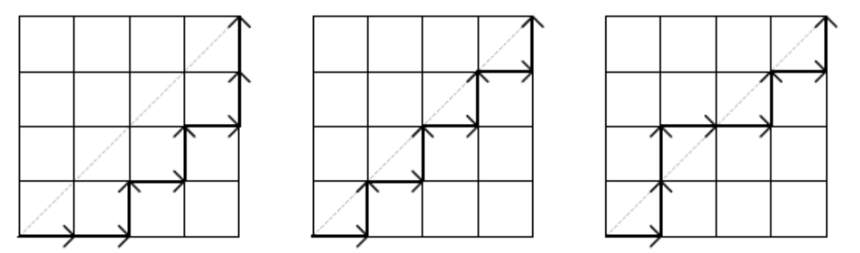
More Counting by Mapping

Slide 2
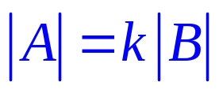
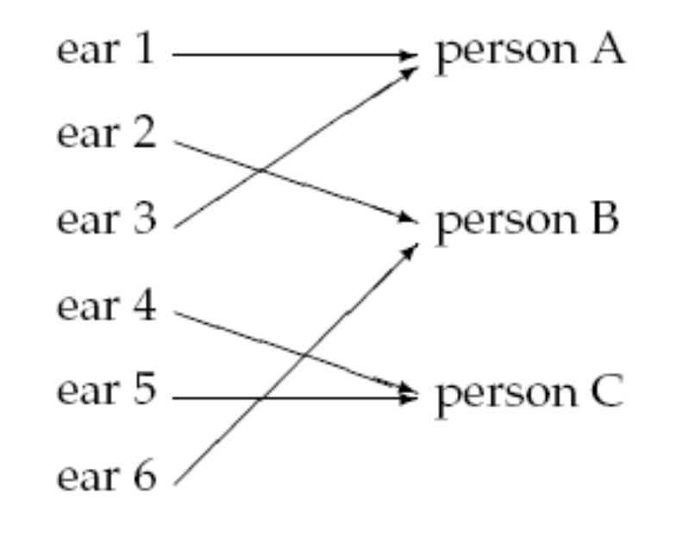
Division Rule
If a function from A to B is k-to-1,
meaning that each element in B is mapped by exactly k elements in A
then
(This generalizes the Bijection Rule.)
e.g.
This is a 2-to-1 function.
So # of ears = 2 x # of people.

Slide 3
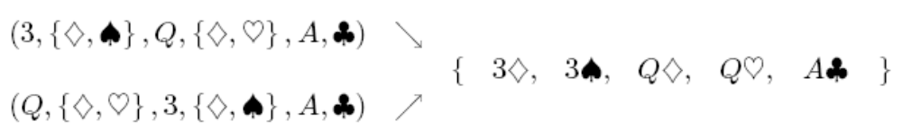
Example 3: Two Pairs
This is something we have encountered before when we counted poker hands.
Double
Count!
A: the set of two pairs
B: the set of sequences which satisfy (1)-(6).
What we did was to show that the mapping from A to B is 1-to-2,
and thus conclude that 2|A| = |B|. Then we compute |B| and then |A|.

Slide 4
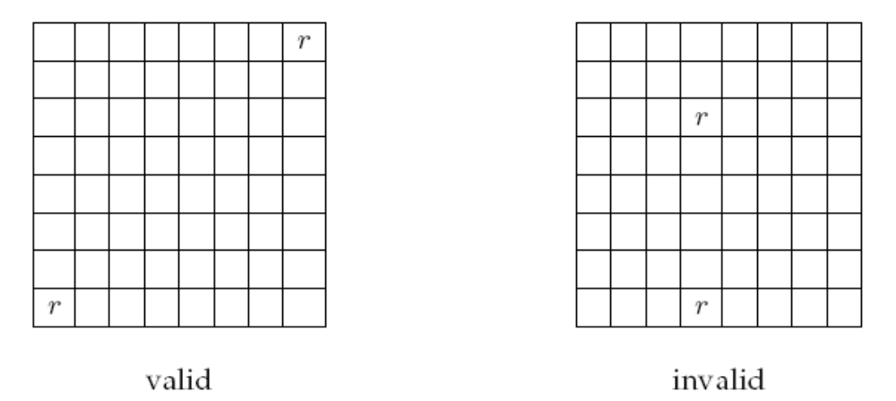
Another Chess Problem
In how many different ways can you place two identical rooks on a chessboard so that
they do not share a row or column?

Slide 5
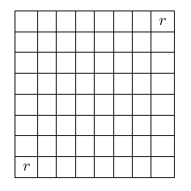
Another Chess Problem
We define a mapping between configurations
to sequences (r(1), c(1), r(2), c(2)),
where r(1) and r(2) are distinct rows,
and c(1) and c(2) are distinct columns.
A ::= all sequences (r(1),c(1),r(2),c(2)) with r(1) ≠ r(2) and c(1) ≠ c(2)
B::= all valid rook configurations
(1,1,8,8) and (8,8,1,1) maps
to the same configuration.
The mapping is a 2-to-1 mapping.

Slide 6

Another Chess Problem
A ::= all sequences (r(1),c(1),r(2),c(2)) with r(1) ≠ r(2) and c(1) ≠ c(2)
B::= all valid rook configurations
The mapping is a 2-to-1 mapping.
Using the generalized product rule to count |A|,
there are 8 choices of r(1) and c(1),
there are 7 choices of r(2) and c(2),
and so |A| = 8x8x7x7 = 3136.
Thus, total number of configurations
|B| = |A|/2 = 3136/2 = 1568.

Slide 7
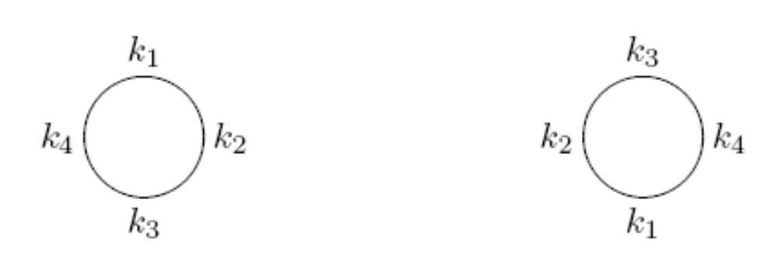
Round Table
How many ways can we seat n different people at a round table?
Two seatings are considered equivalent if one can be obtained from the other by rotation.
equivalent

Slide 8
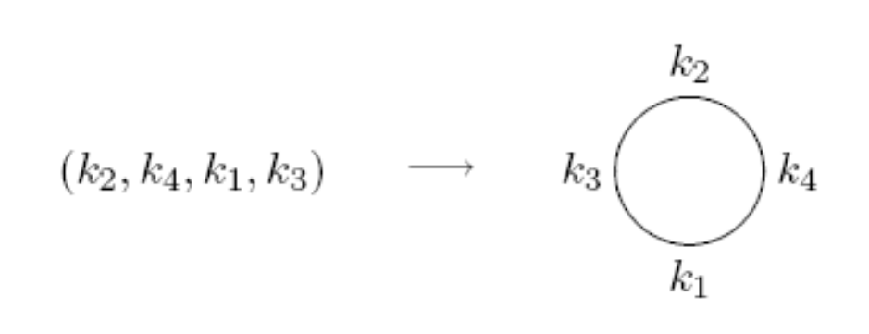
Round Table
A ::= all the permutations of the people
B::= all possible seating arrangements at the round table
Map each permutation in set A to a circular seating arrangement in set B by following the natural order in the permutation.

Slide 9
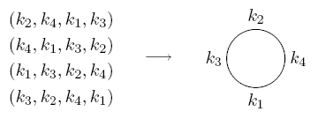

Round Table
A ::= all the permutations of the people
B::= all possible seating arrangements at the round table
This mapping is an n-to-1 mapping.
Thus, total number of seating arrangements
|B| = |A|/n = n!/n = (n-1)!

Slide 10

Counting Subsets
Now we can use the division rule to compute more formally.
How many size 4 subsets of {1,2,…,13}?
Let A::= permutations of {1,2,…,13}
B::= size 4 subsets
map a₁ a₂ a₃ a₄ a₅… a₁₂ a₁₃ to {a₁,a₂ ,a₃, a₄}
(that is, take the first k elements from the permutation)
How many permutations are mapped to the same subset??

Slide 11

Counting Subsets
map a₁ a₂ a₃ a₄ a₅… a₁₂ a₁₃ to {a₁,a₂ ,a₃ , a₄}
a₂ a₄ a₃ a₁ a₅ … a₁₂ a₁₃ also maps to {a₁,a₂ ,a₃, a₄}
as does a₂ a₄ a₃ a₁ a₁₃ a₁₂ … a₅
4!
9!
Any ordering of the first four elements (4! of them),
and also any ordering of the last nine elements (9! of them)
will give the same subset.
So this mapping is
4!9!-to-1

Slide 12

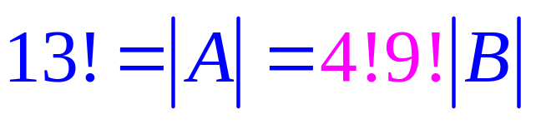
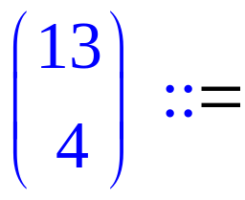
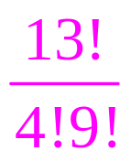
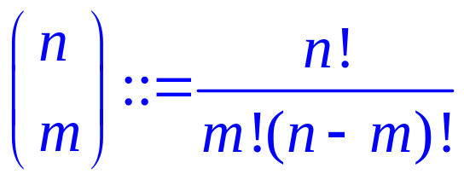
Counting Subsets
Let A::= permutations of {1,2,…,13}
B::= size 4 subsets
So number of 4 element subsets is
Number of m element subsets of an n element set is

Slide 13
MISSISSIPPI
How many ways to rearrange the letters in the word “MISSISSIPPI”?
Let A be the set of all permutations of n letters.
B be the set of all different words by rearranging “MISSISSIPPI”.
How many permutations are mapped to the same word?
4! possible ways to rearrange the S giving the same word
MISSISSIPPI
4! possible ways to rearrange the I giving the same word
2! possible ways to rearrange the P giving the same word
The mapping is 4!4!2!-to-1, and so there are 11!/4!4!2! different words.

Slide 14
Example: 20 Mile Walk
I’m planning a 20-mile walk, which should include 5 northward miles, 5 eastward miles, 5 southward miles, and 5 westward miles.
How many different walks are possible?
There is a bijection between such walks and words with 5 N’s, 5 E’s, 5 S’s, and 5 W’s.
The number of such words is equal to the number of rearrangements:
20!
5!5!5!5!

Slide 15
Exercises
What is the coefficient of x⁷y⁹z⁵ in (x+y+z)²¹?
There are 12 people. How many ways to divide them into 3 teams, each team with 4 people?

Slide 16
This Lecture
Bijection rule
Division rule
More mapping

Slide 17
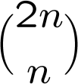
Monotone Path
A monotone path from (0,0) to (n,n) is a path consist of “right" moves (x-coordinate increase by 1) and “up" moves (y-coordinate increase by 1), starting at (0,0) and ending at (n,n).
How many possible monotone paths from (0,0) to (n,n)?
We can map a “right” move to an “x” and a “up” move to a “y”.
There is a bijection between monotone paths and words with n x’s and n y’s.
And so the answer is just

Slide 18
Monotone Path
We say such a path “lower-right" monotone path if all of the points (x_{i},y_{i}) on the path has x_{i} >= y_{i}.
lower-right monotone
NOT lower-right monotone
How many possible lower right monotone paths from (0,0) to (n,n)?

Slide 19
Monotone Path
How many possible lower right monotone paths from (0,0) to (n,n)?
We can still map a “right” move to an “x” and a “up” move to a “y”.
There is a bijection between (A) lower right monotone paths and
(B) words with n x’s and n y’s, with the additional constraint that
no initial segment of the string has more Y's than X's.
There is a bijection, but both sets look difficult to count.

Slide 20
Parenthesis
How many valid ways to add n pairs of parentheses?
E.g. There are 5 valid ways to add 3 pairs of parentheses.
((())) (()()) (())() ()(()) ()()()
Let r_{n} be the number of ways to add n pairs of parentheses.
A pairing is valid if and only if there are at least as many
open parentheses than close parentheses from the left.

Slide 21
Mountain Ranges
How many “mountain ranges” can you form with n upstrokes
and n downstrokes that all stay above the original line?
/\
/\ /\ /\/\ / \
/\/\/\, /\/ \, / \/\, / \, / \
We do not know how to solve these three problems yet, but
we can show that all these three problems have the same answer,
by showing that there are bijections between these sets.

Slide 22
Parenthesis and Monotone Paths
A pairing is valid if and only if there are at least as many
open parentheses than close parentheses from the left.
(()()()) ()()()()
xxyxyxyy
xyxyxyxy
We can map a “(” to an “x” and a “)” move to a “y”.
There is a bijection between (A) valid pairings and
(B) words with n x’s and n y’s, with the additional constraint that
no initial segment of the string has more Y's than X's.
In slide 19, we have seen that there is a bijection between (B)
and the set of lower right monotone paths, so there is a bijection
between (A) and the set of lower right monotone paths.

Slide 23
Parenthesis and Monotone Paths
A pairing is valid if and only if there are at least as many
open parentheses than close parentheses from the left.
A monotone path is “lower-right” if and only if there are at
least as many right moves than up moves from the starting point.
(()()()) ()()()()
So there is a bijection between these two sets by each open
parenthesis with a right move and a close parenthesis by an up move.

Slide 24
Monotone Paths and Mountain Ranges
By “rotating” the images, we see that a path not crossing the diagonal
is just the same as a mountain not crossing the horizontal line.
So there is a bijection between them by mapping “right” to “up” and “up” to “down”

Slide 25
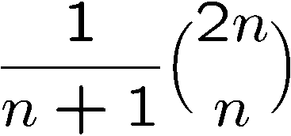
Catalan Number
Now we know that these three sets are of equal size,
although we don’t know the size.
It turns out that the answer is exactly
This is called the nth Catalan number,
and has applications in many other places as well.
We will not compute it in the lecture,
but if there is enough interest I can talk in an extra lecture.

Slide 26
Mapping Between Infinite Sets (Optional)
How to compare the size of two infinite sets?
Cantor proposed an elegant defintion:
Two infinite sets are “equal” if there is a bijection between them.
Using this definition, it can be shown that:
The set of positive integers = the set of integers
The set of integers = the set of rational numbers
The set of integers ≠ the set of real numbers
The idea can be applied to CS, see page 453-454 of the textbook.

Slide 27
Quick Summary
Counting by mapping is a very useful technique.
It is also a powerful technique to solve more complicated problems.
The basic examples usually map a set into a properly defined binary strings.
Then we see how to generalize this approach by considering k-to-1 functions.
Finally we see the mapping between more complicated sets.

